Slide 1
Documentation work repartition
Plan

Slide 2
Content
General plan
Why
What
How
When

Slide 3
General Plan
Overview
Geomatching
SDK
API
Portal

Slide 4
Why ? The developer path.
overview
Before diving into our documentation, users should be able to grasp the idea; the potential of Matchmore
Geomatching
When Matchmore is understood, developers want some quick codes they can copy-paste to try. Finally, they want a full explanation of everything
SDK
Help the developers to install our SDKs and start using our tools. Developers need to be aware of what the SDKs do for them
API
Display RESTFul API Doc
Portal
Managing their account is sometimes hard, explain clearly what they have access.

Slide 5
What ? The content in the section.
Overview
Geomatching
SDK
API
Portal
Matchmore
Example uses
Developer tools
Quickstart
How it works
iOS
Android
JavaScript
Unity 3D
React native ?
Xamarin ?
Dashboard
Apps
Beacons
Docs
Tools
Phomo?
What is my account for ?
Billing
Pricing
NEXT: SDK’s section content TO DO : Check difference and parity SDKs

Slide 6
What should contain a SDK section ?
Getting started (Installations, alternatives installations, example for ios: cocoapods, framework, carthage, source)
Configuration
Configure project (Request permission)
Add SDK to project
Start/stop Matchmore
Start/Stop updating location
For iOS/Android : Configure LocationManager
Foreground update locations
Background update locations
Manual update locations
Tutorials
Create a Mobile Device
Create a Pin Device
Create a Beacon Device (Except for SDKs that don’t support beacons yet)
Start/Stop Monitoring for device, APNS/FCM, WebSocket and Polling
Publish
Subscribe
GetMatches
Local CRUD request (Create, Find, FindAll, Delete and DeleteAll)
Changelog
Supported Platform

Slide 7
Matrix supported features SDKs
SDK features | RESTFul API | iOS | Android | JavaScript | Unity 3D | React | Xamarin
IOT Supported :
Mobile | ✅ | ✅ | ✅ | ✅ | ✅ | ✅ | ✅
Pin | ✅ | ✅ | ✅ | ✅ | ✅ | ✅ | ✅
Beacon | ✅ | ✅ | ✅ | ❌ | ❌ | ❌ | ❌
Persistency:
Device | ❌ | ✅ | ✅ | ❌ | ❌ | ❌ | ❌
Pub/Sub | ❌ | ✅ | ✅ | ❌ | ❌ | ❌ | ❌
Match | ❌ | ✅ | ✅ | ❌ | ❌ | ❌ | ❌
Custom Location Mode :
Foreground Mode | ❌ | ✅ | ✅ | ✅ | ✅ | ✅ | ✅
Background mode | ❌ | ✅ | ✅ | ✅ | ✅ | ✅ | ✅
Terminated mode | ❌ | ✅ | ❌ | ✅ | ✅ | ✅ | ✅
Getting Matches via :
Push notification (APNS, FCM) | ✅ | ✅ | ✅ | ✅ | ✅ | ✅ | ✅
WebSocket | ✅ | ✅ | ✅ | ✅ | ✅ | ✅ | ✅
Polling | ✅ | ✅ | ✅ | ✅ | ✅ | ✅ | ✅
Local states request :
Device | ❌ | ✅ | ✅ | ❌ | ❌ | ❌ | ❌
Pub/sub | ❌ | ✅ | ✅ | ❌ | ❌ | ❌ | ❌
Match | ❌ | ✅ | ✅ | ❌ | ❌ | ❌ | ❌

Slide 8
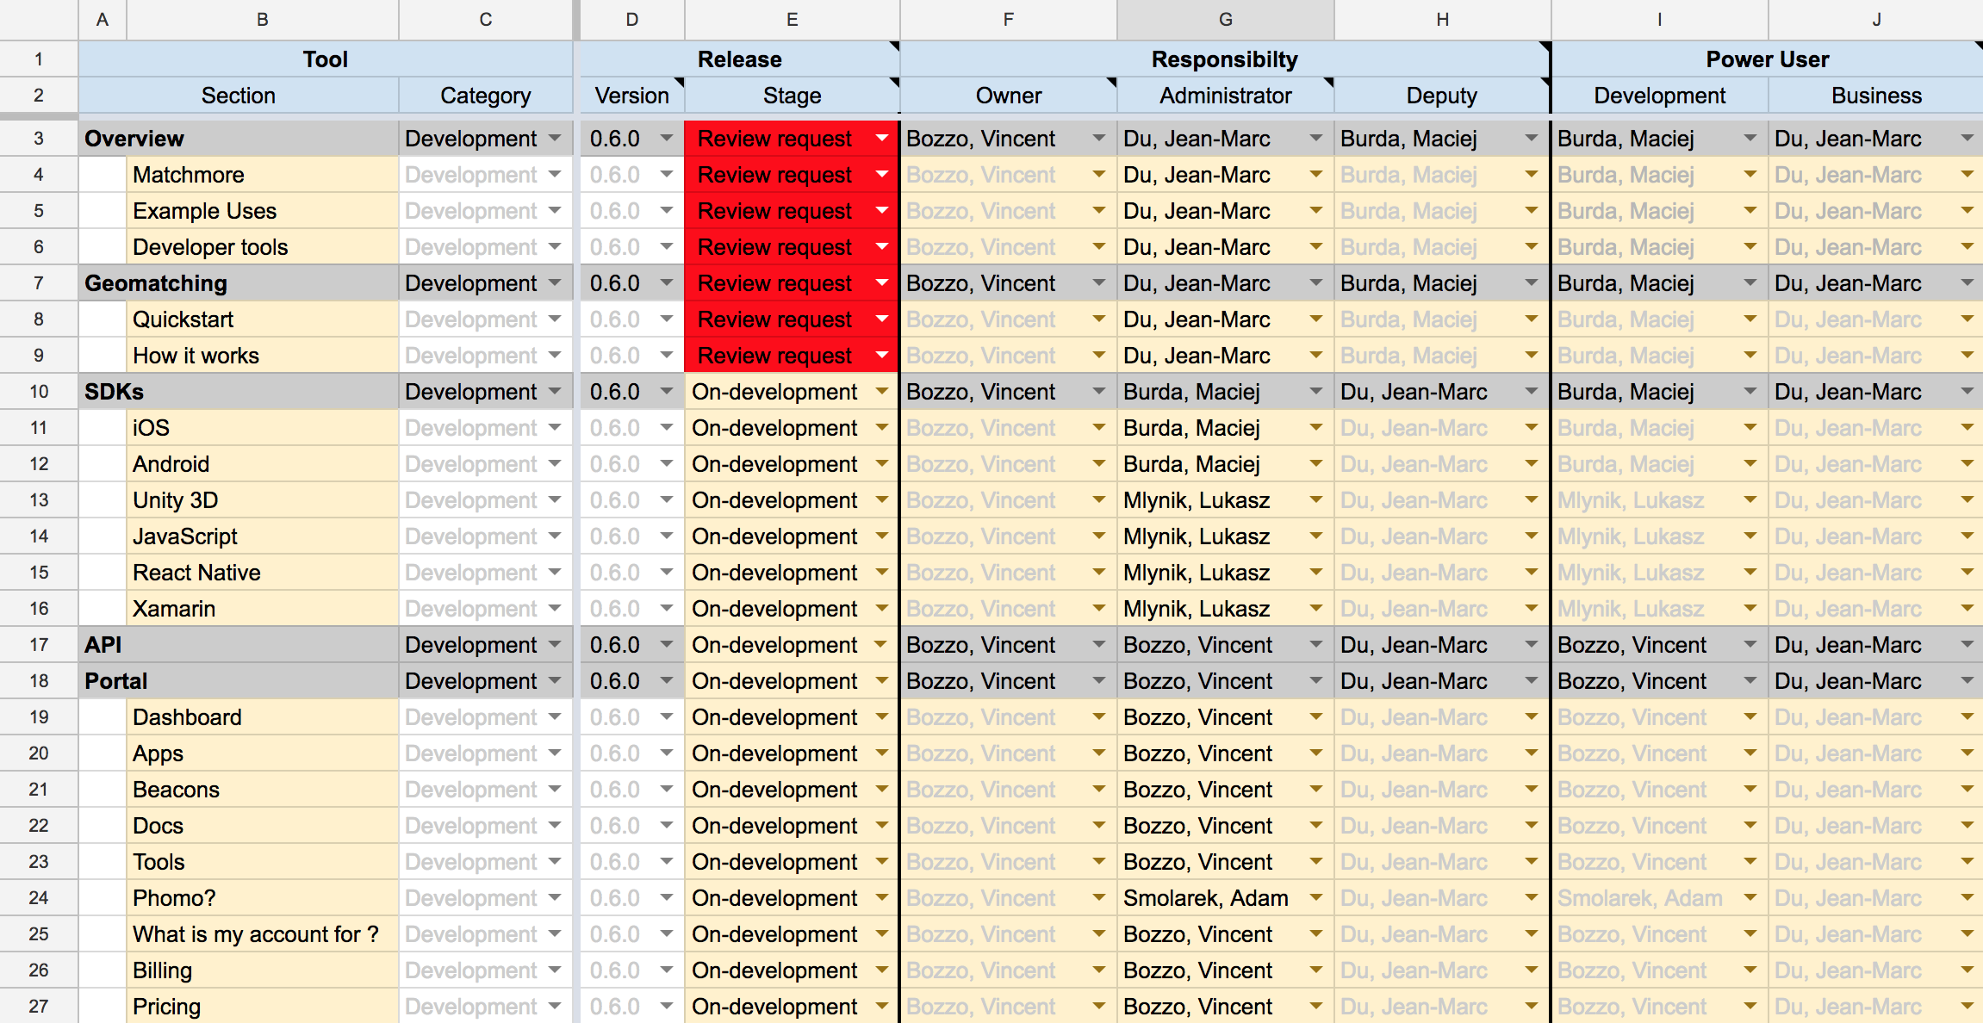
How ? Every Administrator is responsible to maintain their sections. Helps will come from their Deputy. More information available in : https://drive.google.com/open?id=1FhdFw8yWA4TGiAImq06J4mZ8nqFSY96jTnlqOs9PYpM

Slide 9
When ? Planning plan May – June 2018
2018 | 07.05 - 11 | 14 - 18 | 21 - 25 | 28 - 01.06 | 04 - 08 | 11 - 15 | 18 - 22 | 25 - 29 | 02.07 - 06 | 09 - 13
Integration
Writing
Reviewing
Production
Take FeedBack
Maintenance
17th May: ReactNative SDK
1st June: Xamarin SDK
Writing
Review & correction
Production
Feedback from outside
Maintenance
POC MJF
POC MSO
Milestone 1
Integration of theme and template for documentation rendering
Milestone 2
Finished writing, we have a first version to rely on. Not perfect but enough.
Milestone 3 Correction are ready to be published on prod.
Milestone 4
Documentation is ready.
Milestone 5
We got a good idea of where we wants to head with our documentation

Slide 10
Thank you for your Contribution !

